Slide 1
Zebras in the Night
I can create a drawing of a zebra using neutral colors.

Slide 2
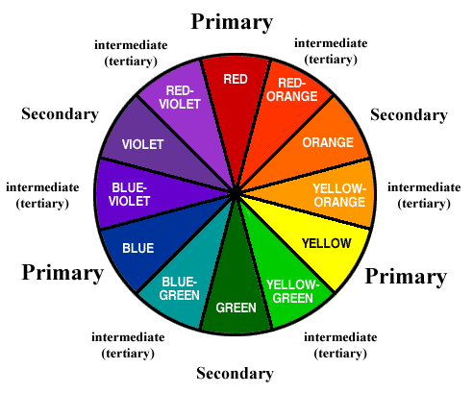
Neutral Colors
Colors that aren’t on the color wheel

Slide 3
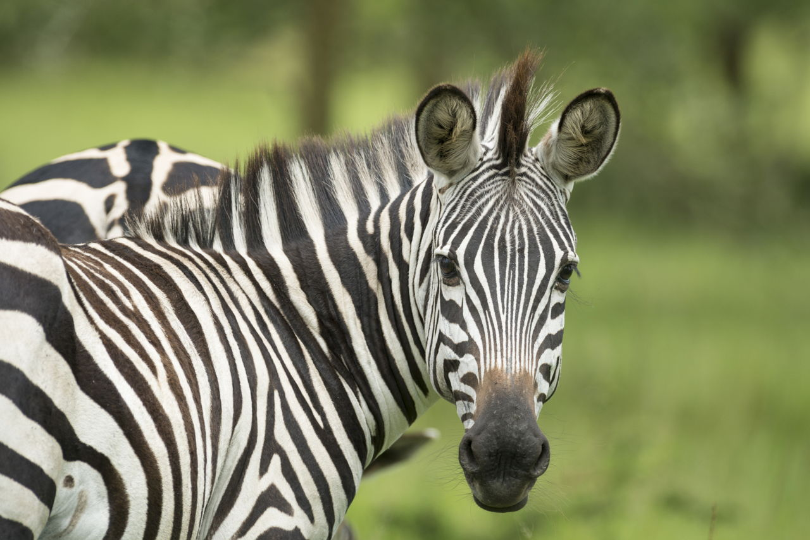
This zebra has three neutral colors!
Black
White
And Brown

Slide 4
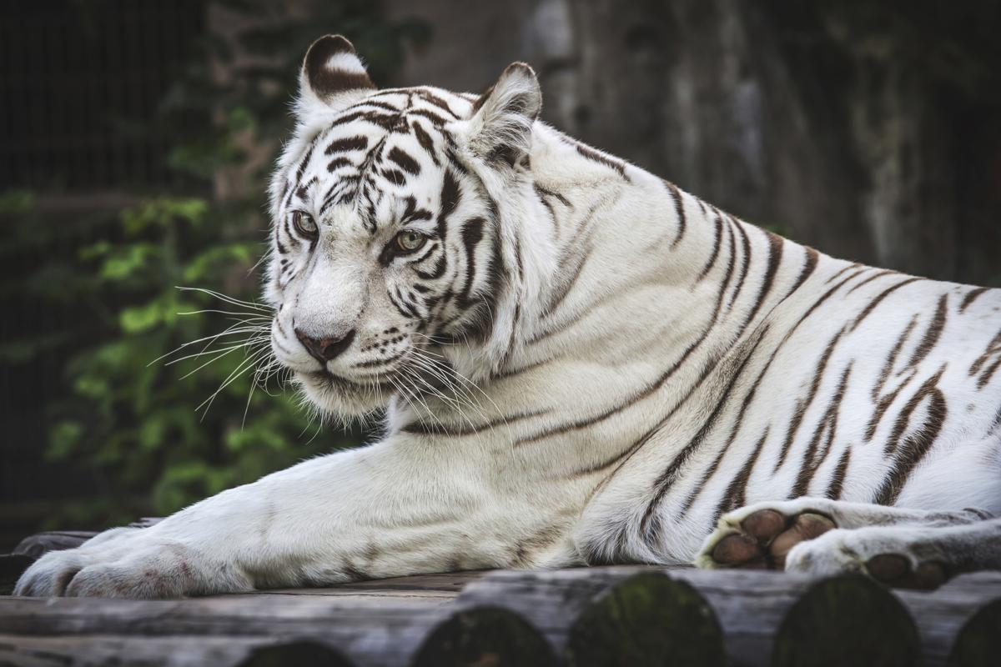
There are other animals with neutral colors too!

Slide 5
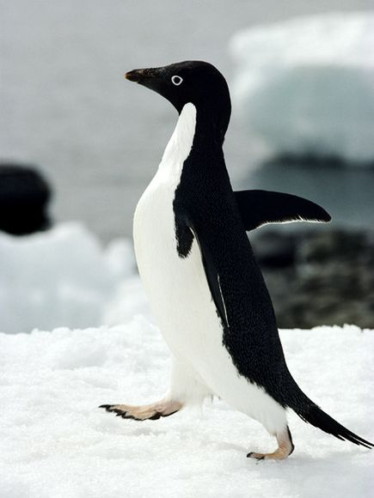
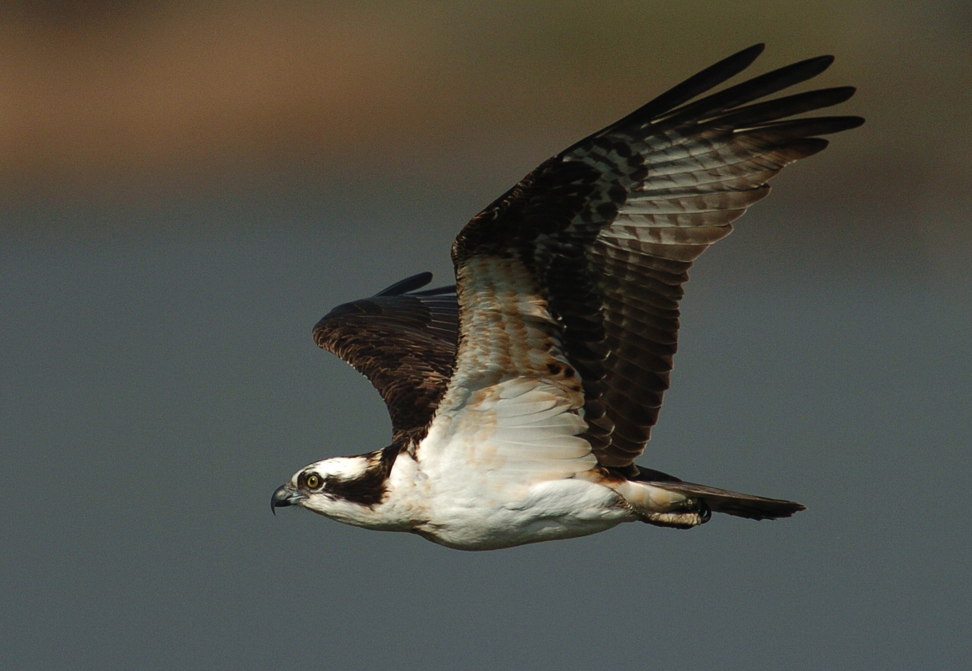

Slide 6
Let’s get Started!
I can create a drawing of a zebra using neutral colors.

