Slide 1
Movie Posters as an Intro to Photoshop

Slide 2
Movie Posters vs. Movie Trailers

Slide 3
Star Trek 2: Into Darkness
https://www.youtube.com/watch?v=QAEkuVgt6Aw

Slide 4
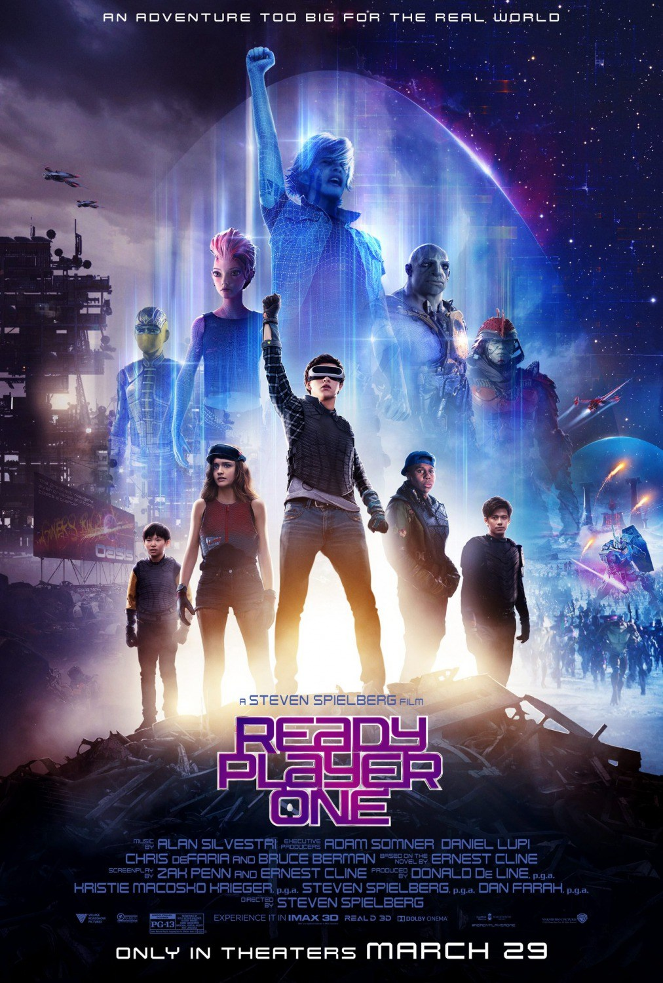

Slide 5
Ready Player One
https://www.youtube.com/watch?v=ixWL1BWi44U

Slide 6
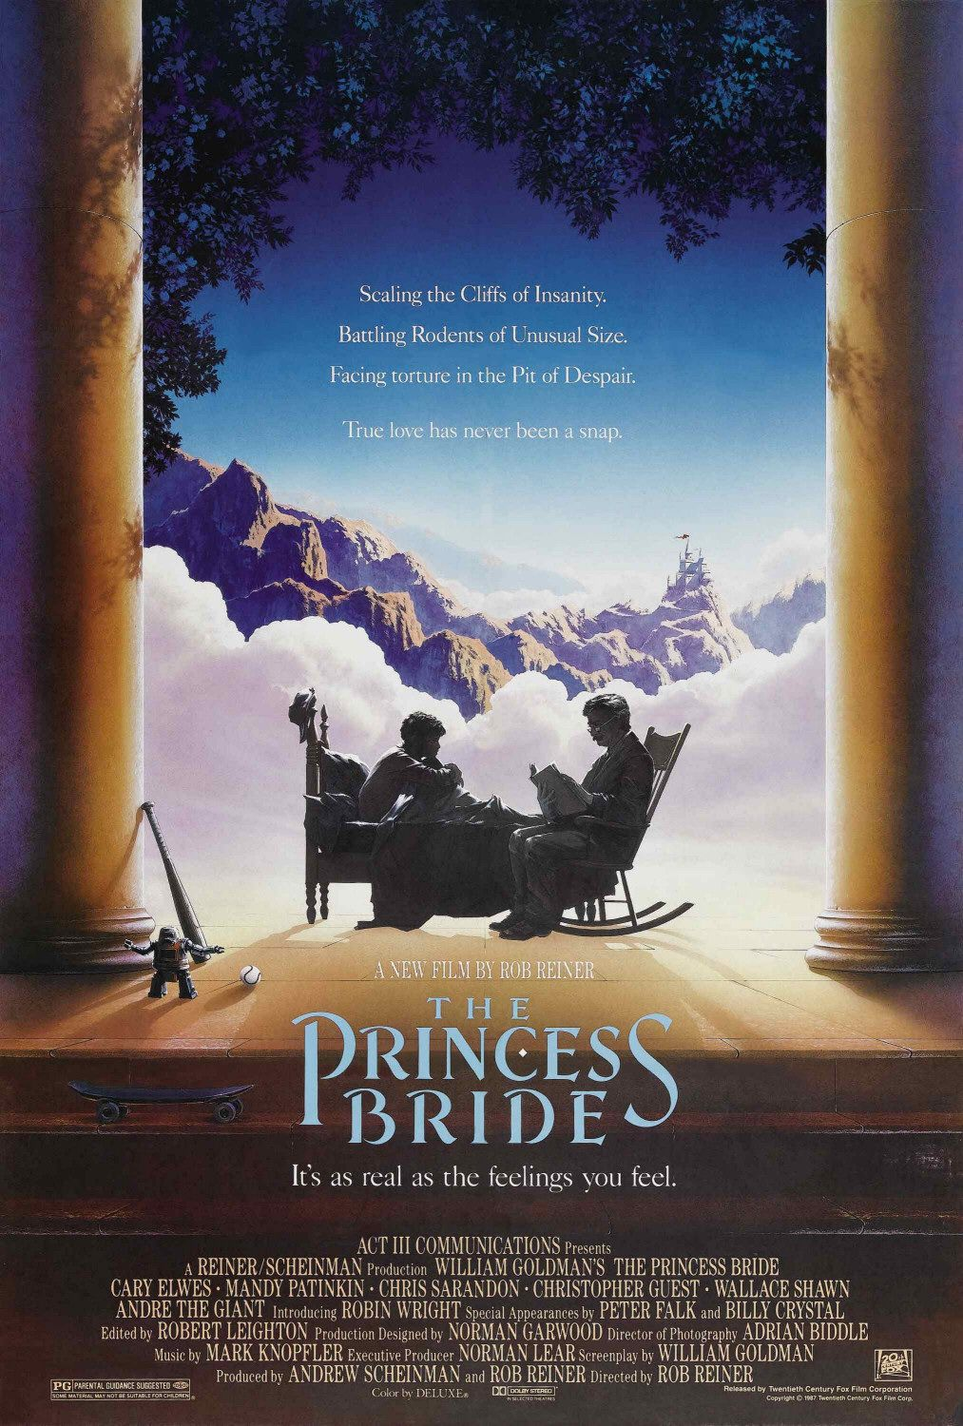
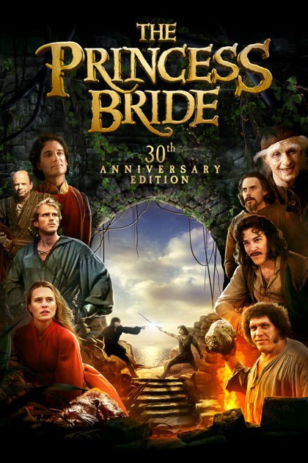

Slide 7
The Princess Bride
https://www.youtube.com/watch?v=WNNUcHRiPS8

Slide 8
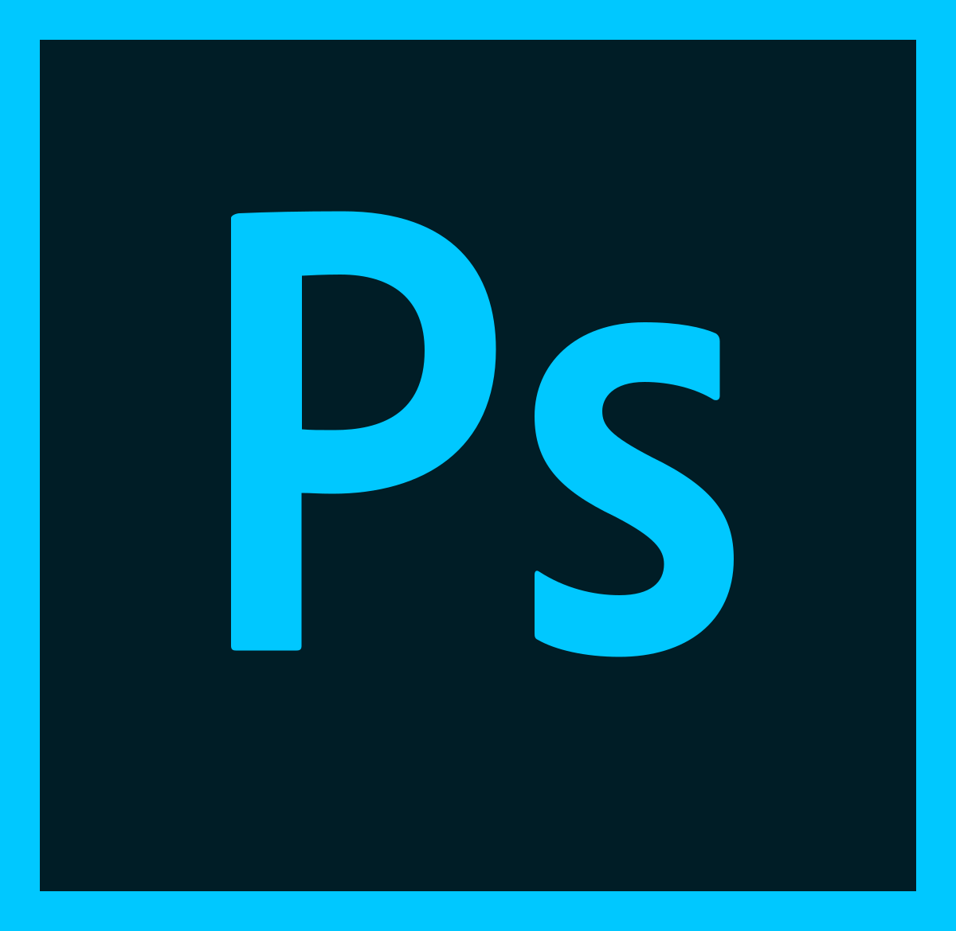
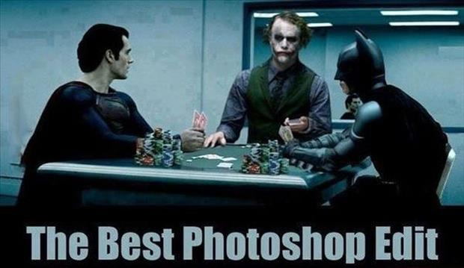
Introduction to PhotoShop

Slide 9
Tools of the Trade
Way too many to go in-depth with right away.
Most Important and the MVT(s) of Photoshop—“Undo (CTRL+z) and Step Back (Ctrl+Alt+z)”
Lasso/Selection/Magic Wand Tool
Text Tool
Clipping Masks

Slide 10
References to Tools & Demo
Lasso/Selection/Quick Selection/Wand Tools: https://www.youtube.com/watch?v=J_GGu_ZaHbQ
Text Tool: https://www.youtube.com/watch?v=ap4lj7FBIh0
Clipping Mask: https://www.youtube.com/watch?v=-j0mzTSTQKs

Slide 11
What you’ll be doing—Movie Posters
Choose a movie poster that catches your eye
Use it as a guide for your own poster
How so?
Note the prominent features of the poster. What pulls your focus? What is featured?
Create a template using the main focuses you find in the poster.
Apply your 15 beats photos and use them to create a movie poster for your short-film.

Slide 12
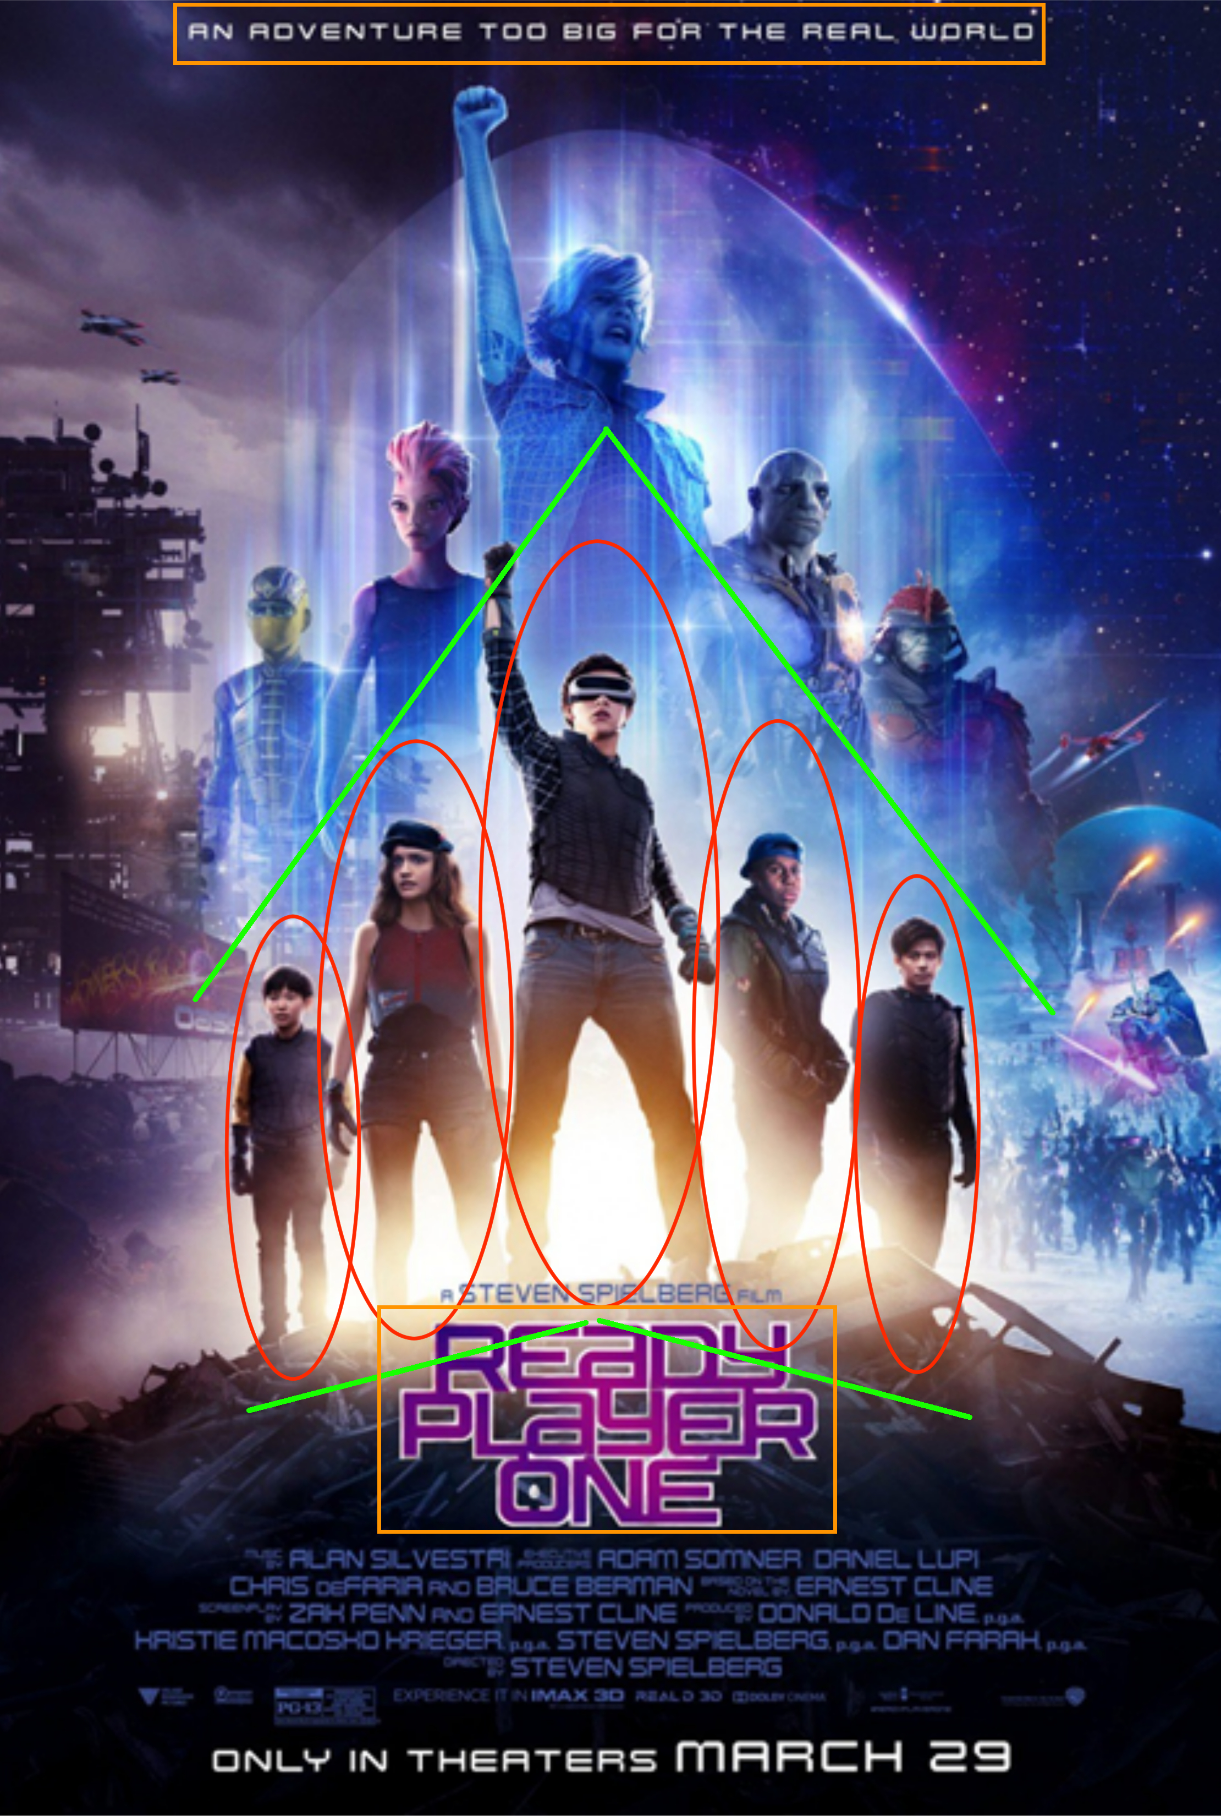
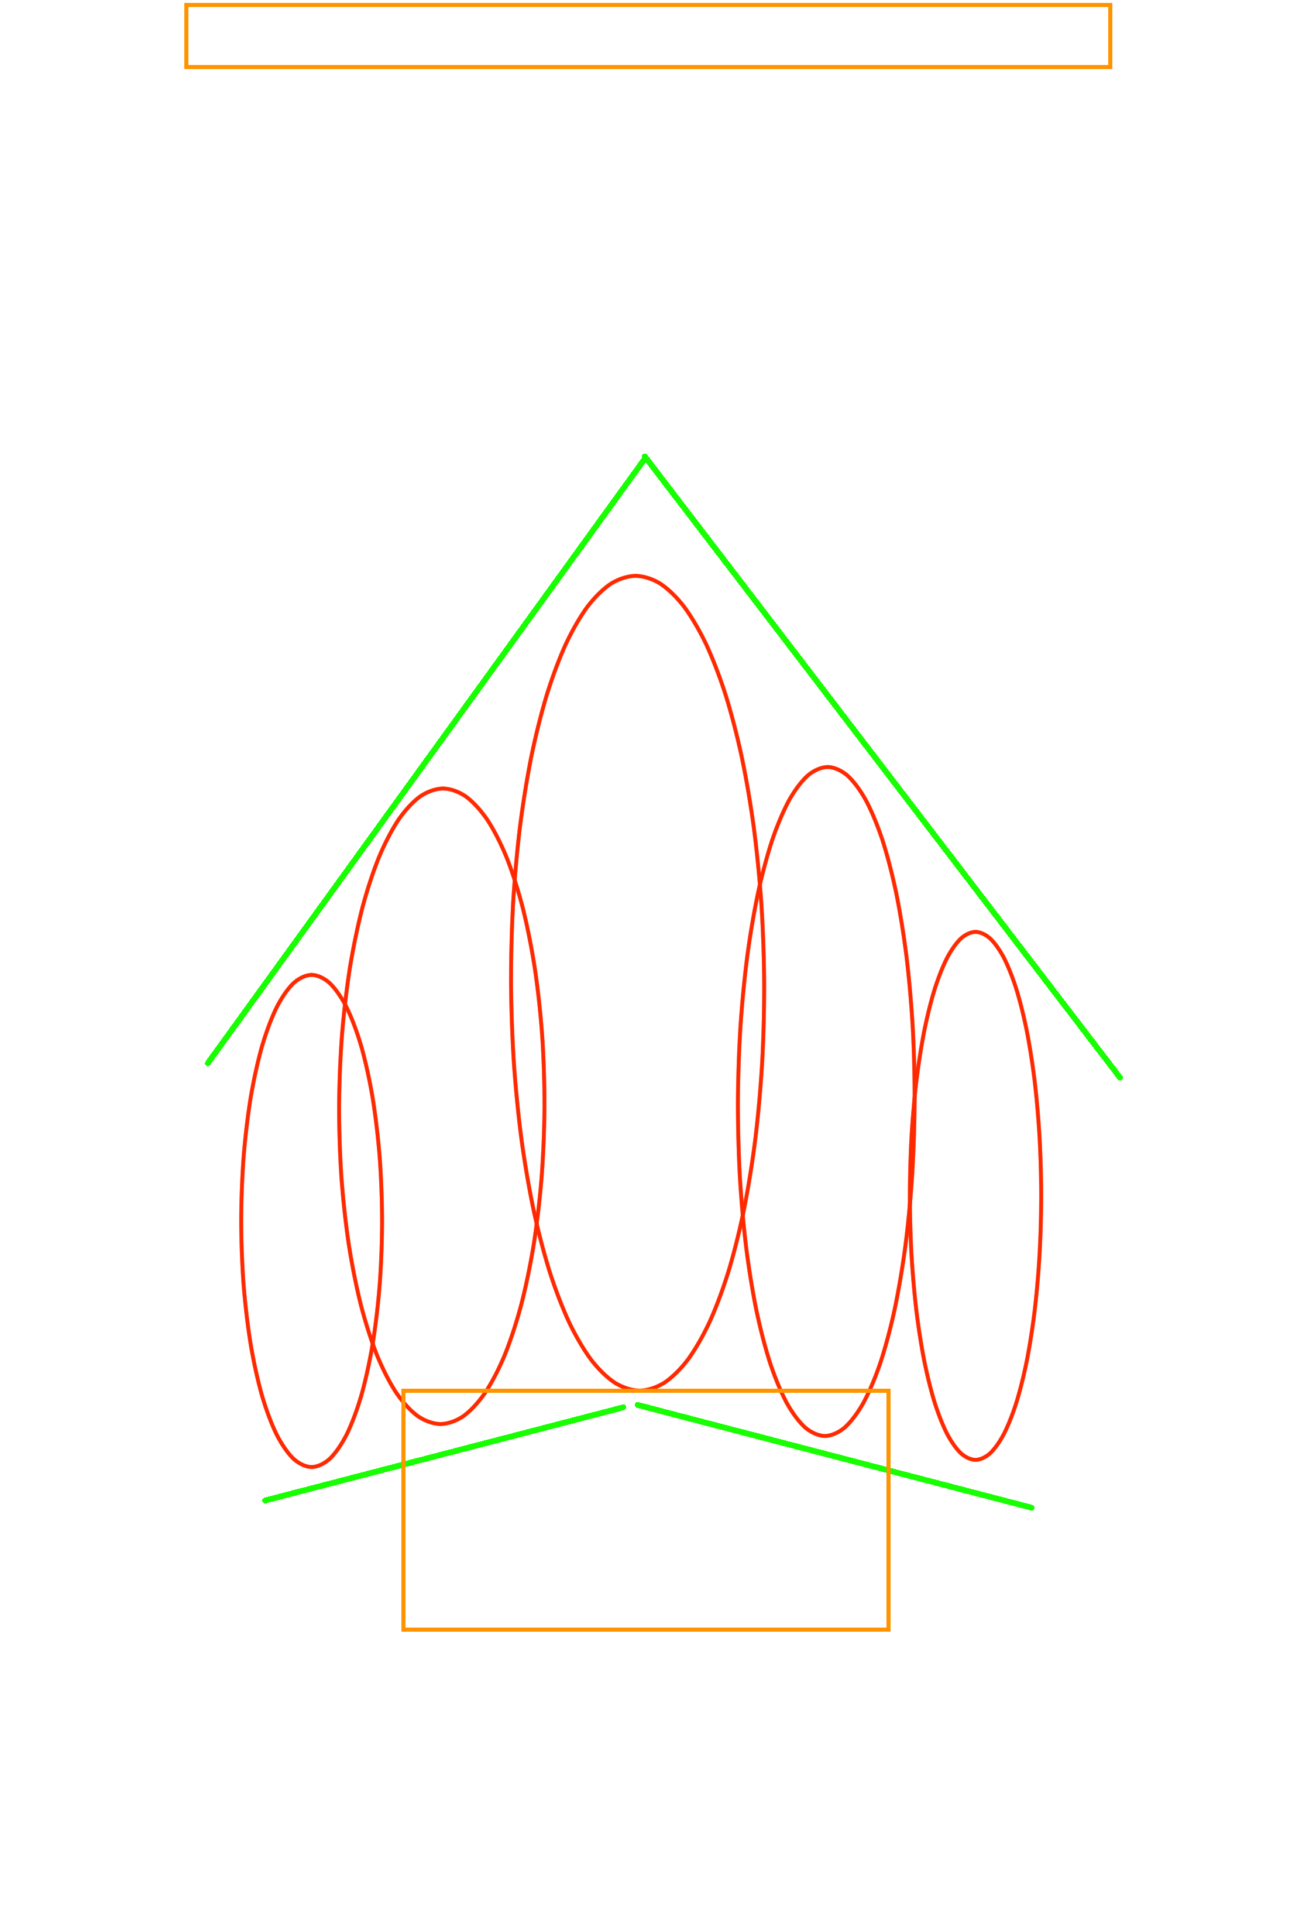

Slide 13
Go! Be Free! Use your Time Wisely
Feel free to ask questions.
If possible, create a draft of what you’re thinking on paper and give back to Mr. Schreiner. He needs evidence because of tedious reasons in educational courses. Much appreciated.

