Slide 1
Crash Course in Color Theory
Wonderful, wonderful color

Slide 2
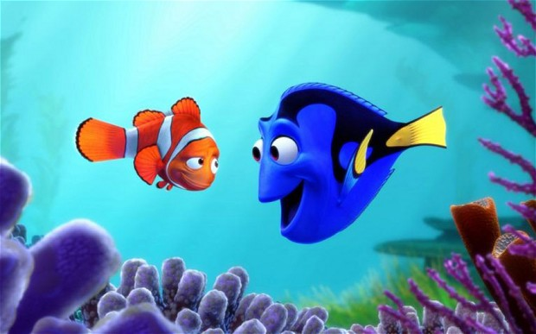
What is Color Theory?
Color theory is a body of practical guidance to color mixing and the visual effects of a specific color combination.

Slide 3
What is Color Theory?
There are, also, definitions (or categories) of colors based on the color wheel: primary color, secondary color, and tertiary color

Slide 4
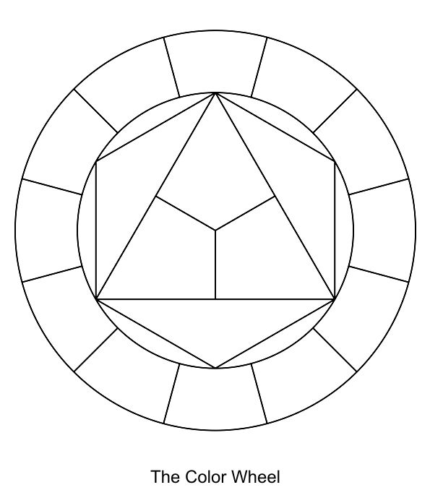
What are the Primary colors and what are the Secondary colors?
Notes:
🍐 This is a Pear Deck Text Slide
🍐 To edit the type of question, go back to the "Ask Students a Question" in the Pear Deck sidebar.

Slide 5
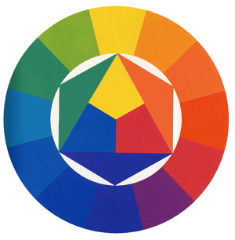
Primary Colors
Red
Blue
Yellow
Secondary Colors
Orange
Green
Purple
Tertiary Colors
The hyphenated colors in between

Slide 6
Warm vs. Cool Colors

Slide 7
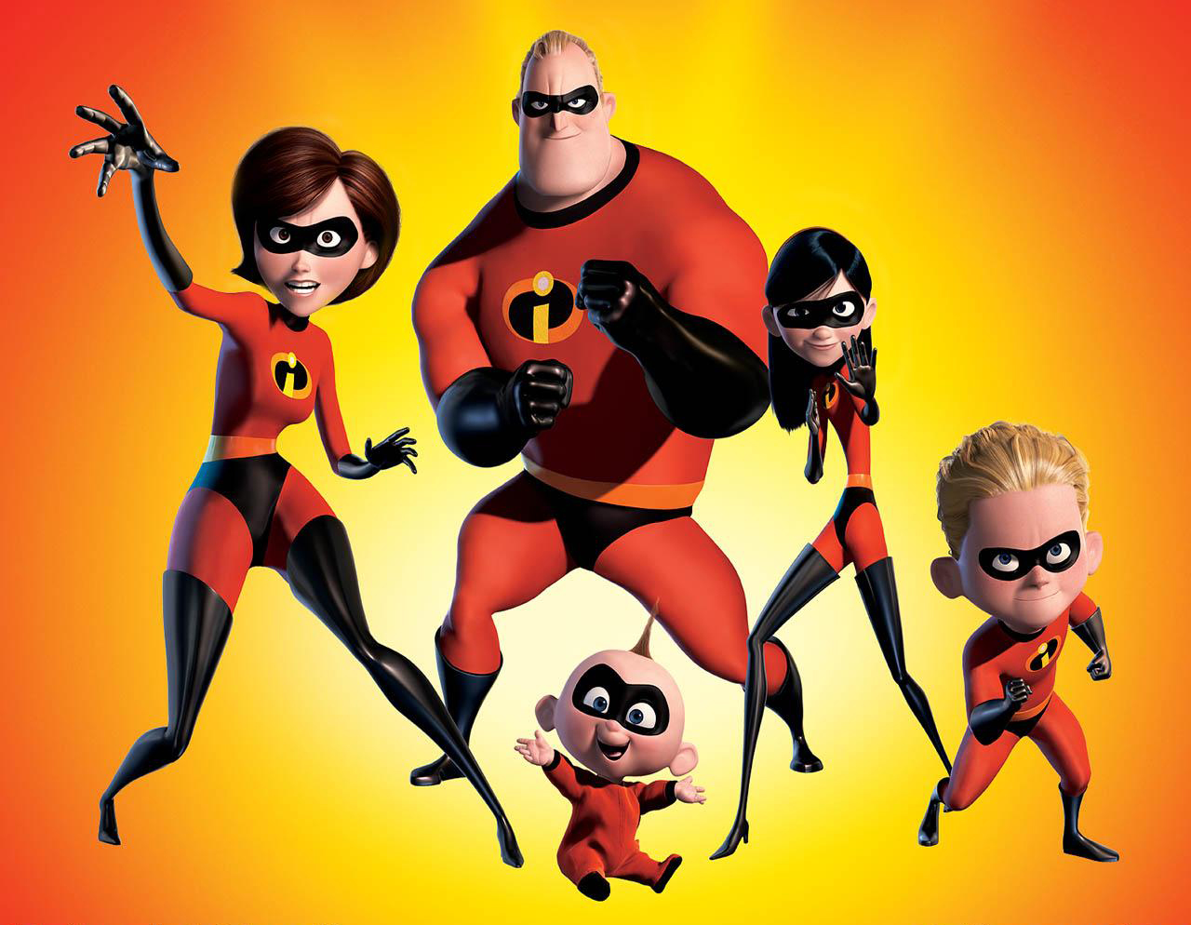
Warm Colors
These are going to be the ones that you usually associate with warmer things: fire, the sun, happiness, anger, etc. They are not limited to these types of depictions, but are often described in this manner.
Red
Yellow
Orange

Slide 8
Cool Colors
Contrary to warm colors, these are the ones that tend to be associated with rain, snow, sorrow, calm, etc.
Green
Blue
Violet/Purple

Slide 9
Examples of Both
Give an example of an object that is a warm color and one that is a cool color.
Notes:
🍐 This is a Pear Deck Text Slide
🍐 To edit the type of question, go back to the "Ask Students a Question" in the Pear Deck sidebar.

Slide 10
Complementary Colors and Contrast

Slide 11
Opposite Ends of the Circle
The way to determine complementary colors is where they are on the color wheel.
When placed correctly, a line can be drawn straight across from one color to the next.
Red to Green
Blue to Orange
Purple to Yellow

Slide 12
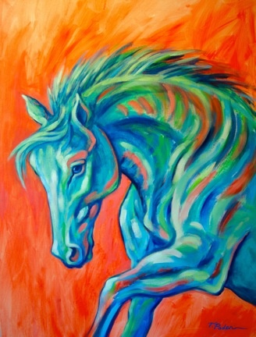
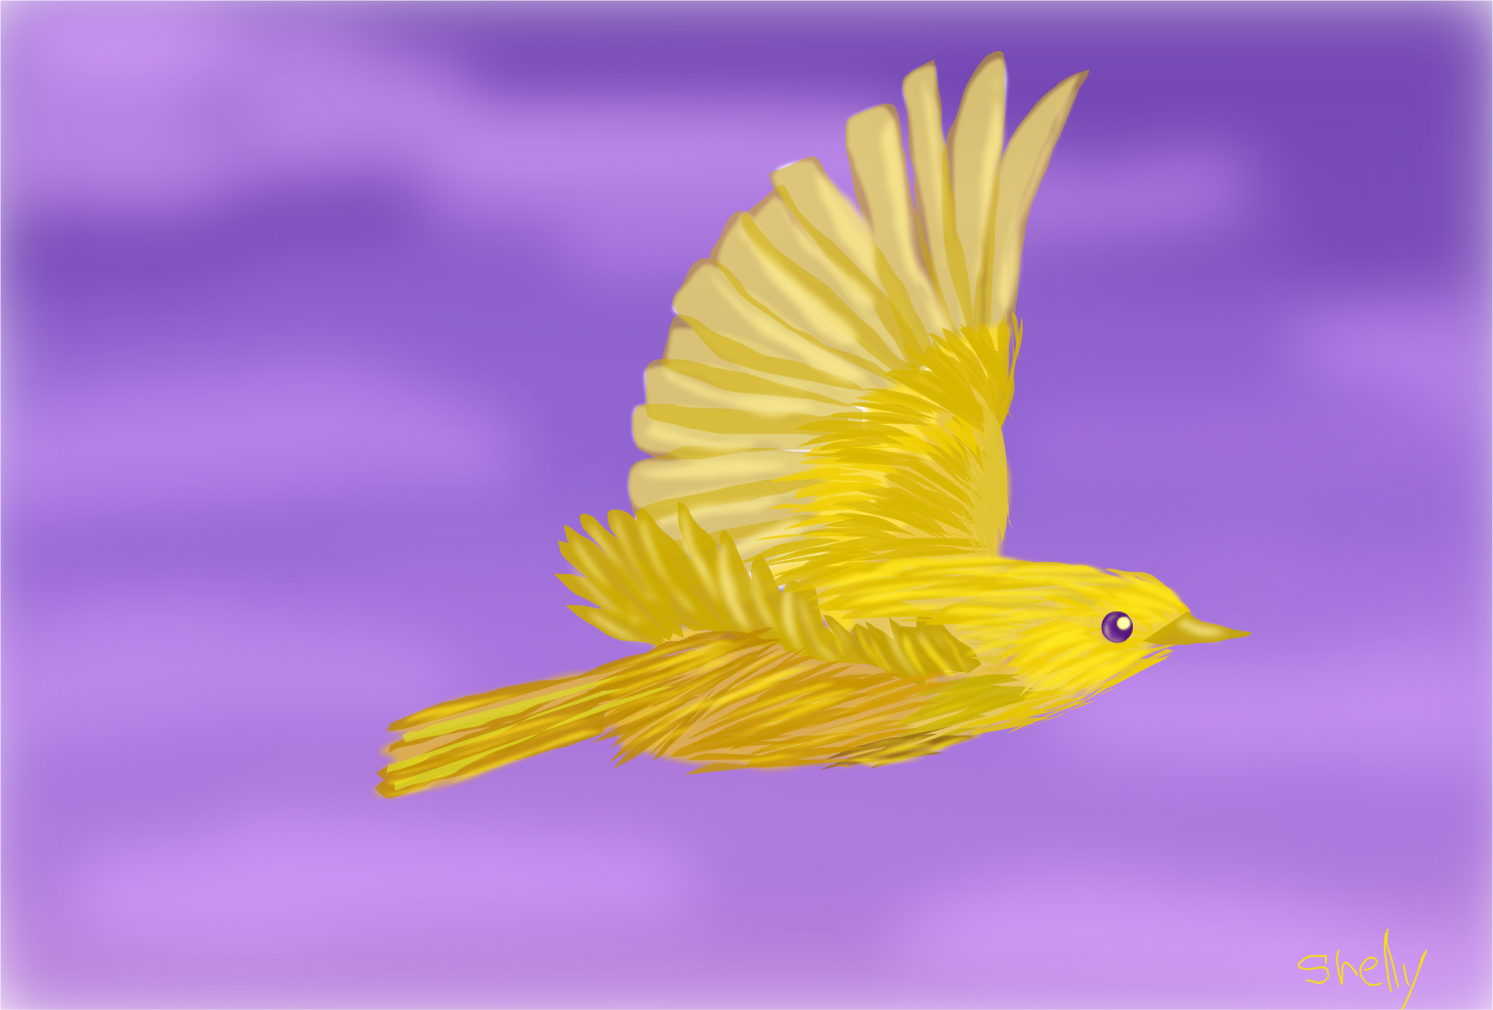
Using Complementary for Contrast
When using complementary colors, you can utilize them to create contrast and bring attention to your subject matter.

Slide 13
Draw a line connecting a pair of complementary colors together.
Notes:
🍐 This is a Pear Deck Drawing Slide
🍐 To edit the type of question, go back to the "Ask Students a Question" in the Pear Deck sidebar.

Slide 14
Neutral Colors

Slide 15
Not too much and not too little
These are your grays, blacks, whites, and browns within the color spectrum.

Slide 16
Neutral Colors vs. Warm & Cool Colors
Neutrals do not lean to one emotion/feeling or the other.
They are a grounding color in the sense of creating a balanced calm.
Certain colors can be used to create a sense of calm, but will then stand out against other colors that are used.
Neutral colors are a calm void that balance with most colors on the color wheel.

Slide 17
How are we feeling about things?
Primary, Secondary, and Tertiary Colors | Awesome and Ready to Rumble | On the Road to Awesome | Doing Good | Some Slight Confusion but Doing Okay | My Head is Spinning with Color
Warm & Cool Colors | Awesome and Ready to Rumble | On the Road to Awesome | Doing Good | Some Slight Confusion but Doing Okay | My Head is Spinning with Color
Complementary Colors | Awesome and Ready to Rumble | On the Road to Awesome | Doing Good | Some Slight Confusion but Doing Okay | My Head is Spinning with Color
Neutral Colors | Awesome and Ready to Rumble | On the Road to Awesome | Doing Good | Some Slight Confusion but Doing Okay | My Head is Spinning with Color
Notes:
🍐 This is a Pear Deck Draggable™ Slide.
🍐 To edit the type of question, go back to the "Ask Students a Question" in the Pear Deck sidebar.

Slide 18
Color Theory in a Nutshell
Primary Colors
Red, Blue, Yellow
Secondary Colors
Purple, Green, Orange
Tertiary Colors
Red-violet, Yellow-green, Orange-yellow, etc.
Warm Colors
Red, Orange, Yellow
Associated with warmth, happiness, anger, passion
Cool Colors
Green, Blue, Purple/Violet
Associated with cold, calm, sorrow, curiosity
Complementary Colors
Purple & Yellow, Red & Green, Blue & Orange
Can be used to create contrast
Neutral Colors
Grays, Blacks, Whites, and Browns
Are a calm neutral that work with most colors

