Slide 1
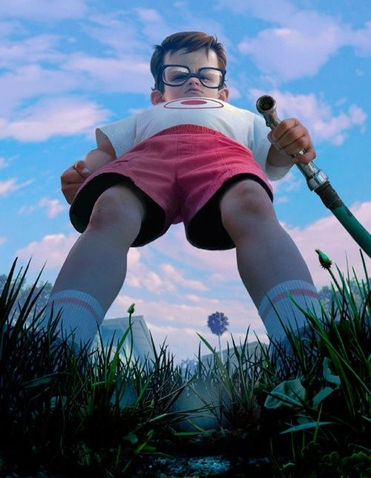
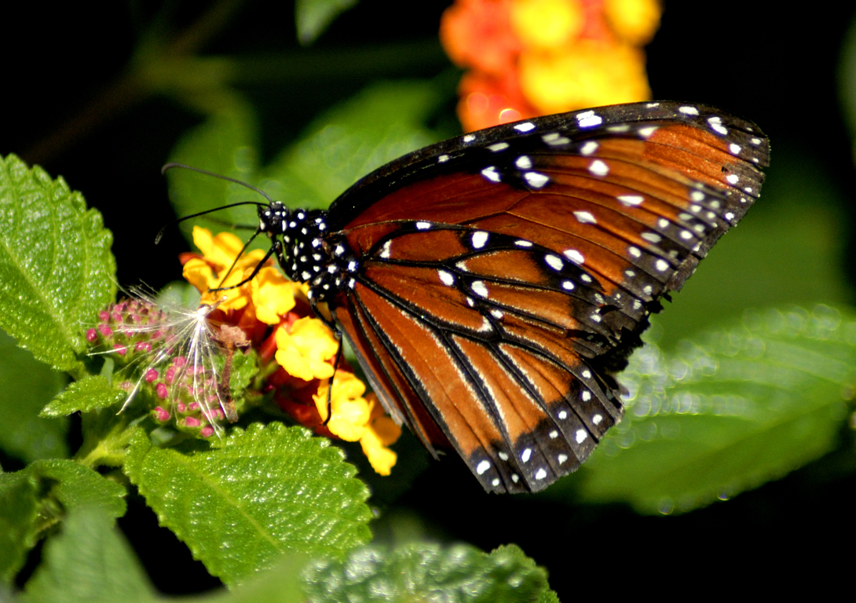
A Bug’s Life View
I can create a 1-point perspective, worm’s eye view drawing of myself and a bug using pencil, sharpie, and oil pastel.

Slide 2
What is “Perspective”?
…?...

Slide 3
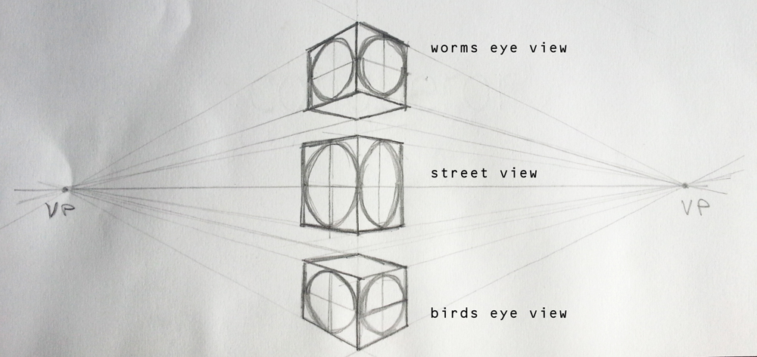

Slide 4
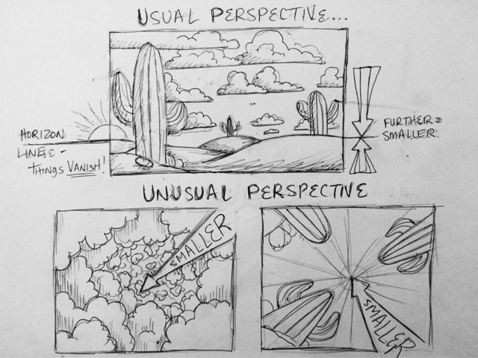

Slide 5
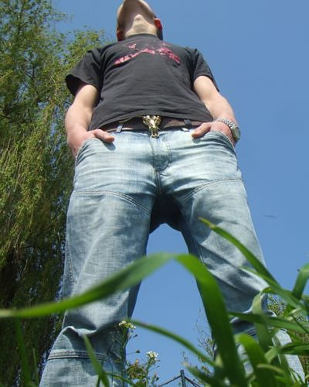
Worm’s Eye View

Slide 7
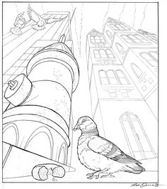

Slide 8
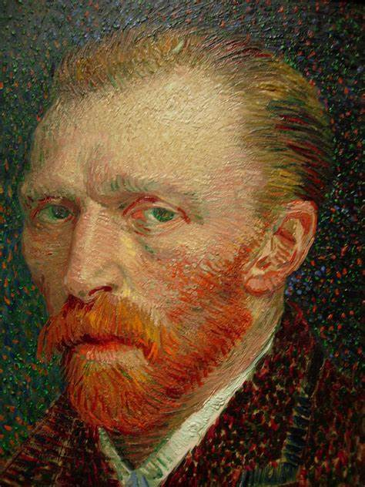
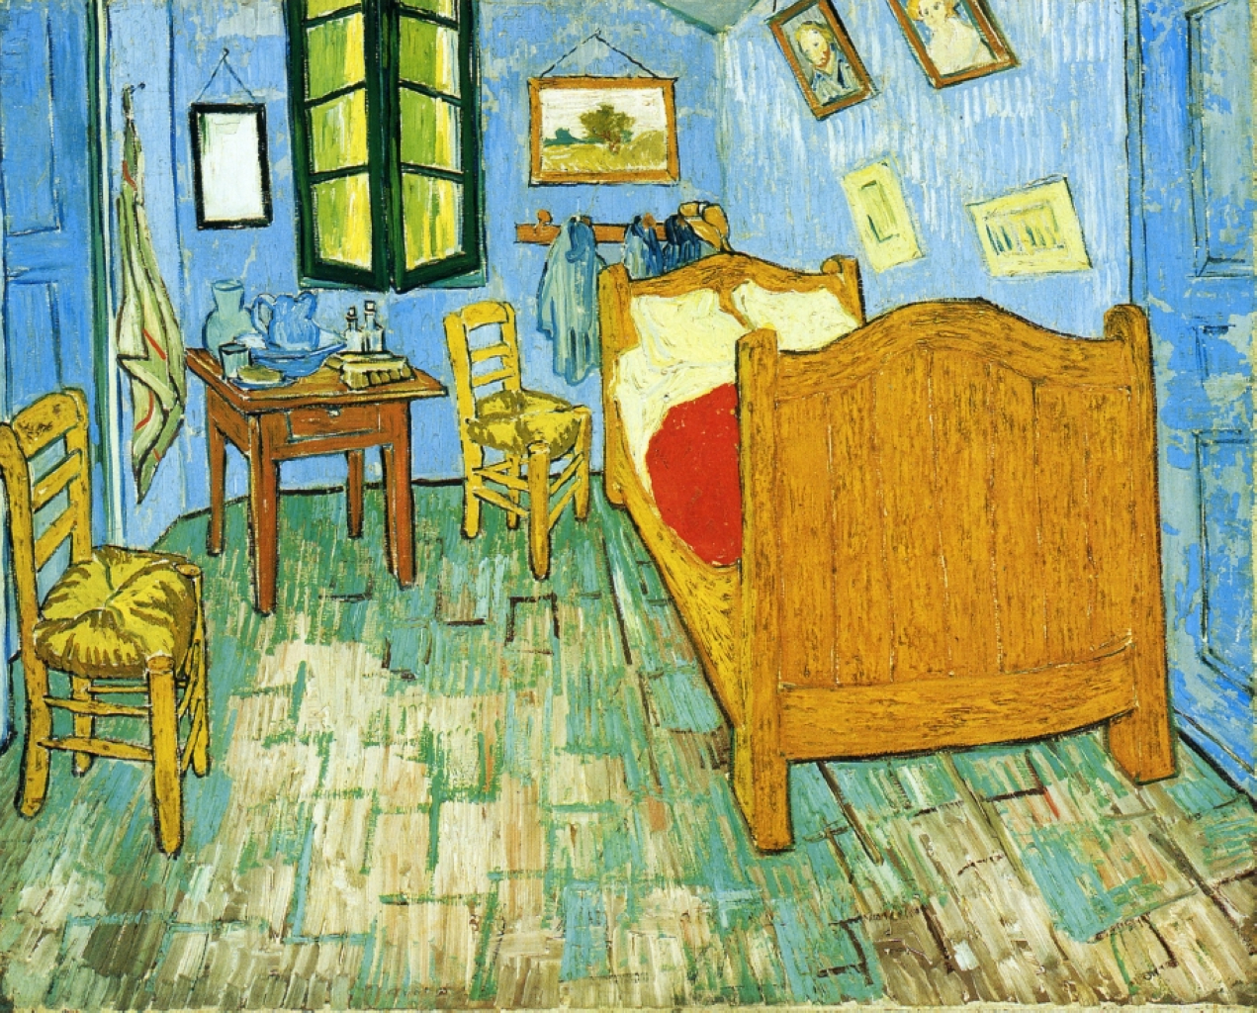
Artist from History: Vincent van Gogh
Bedroom in Arles

Slide 9
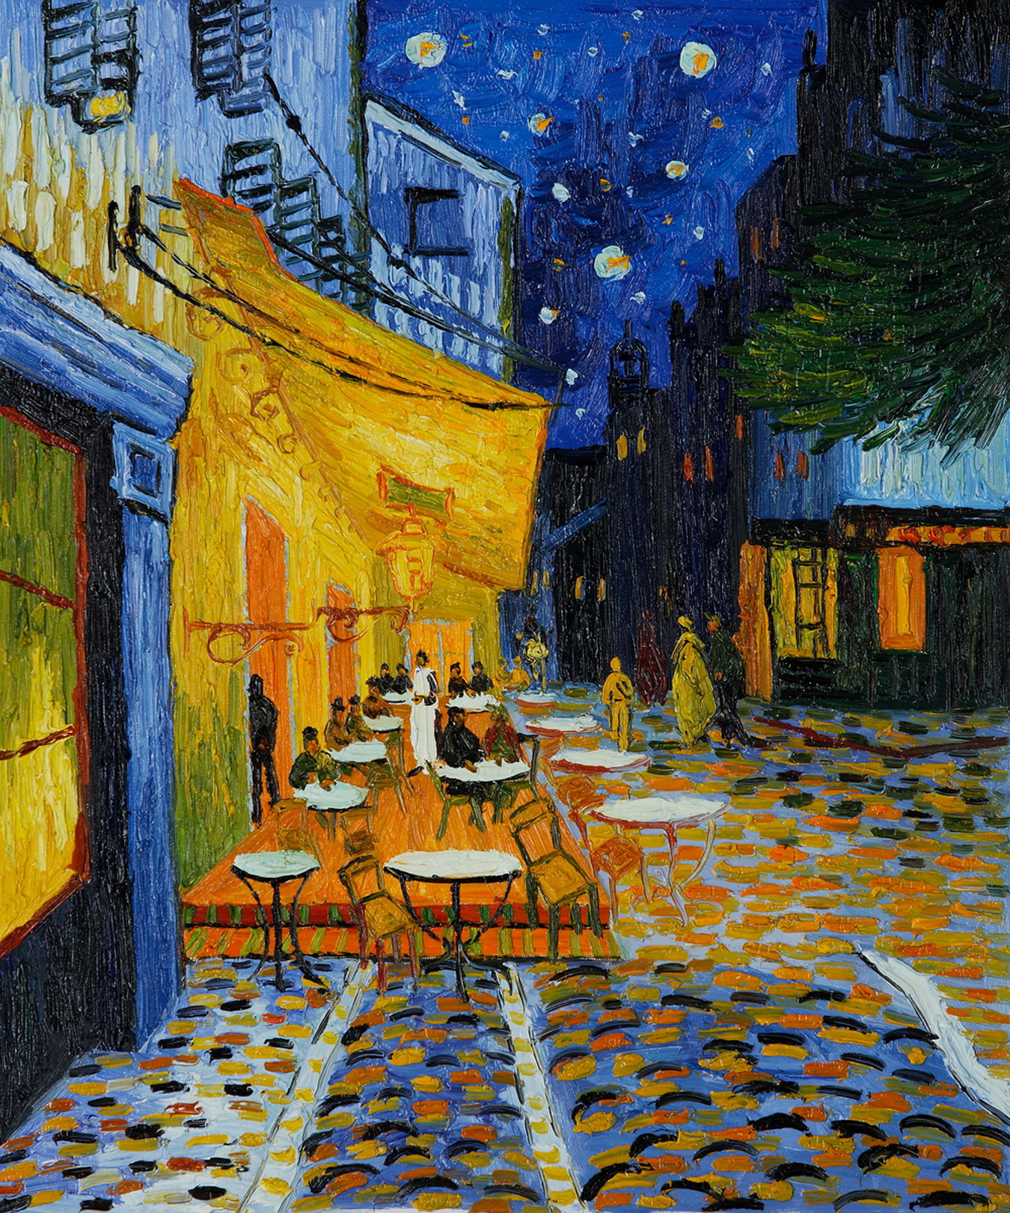
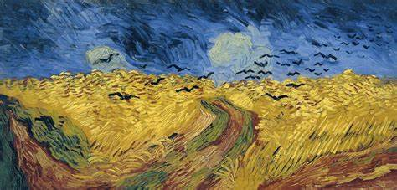
Artist from History: Vincent van Gogh
Crows in the Wheat Field
Café Terrace at Night

Slide 10
Day 1: Establish Your Perspective
I can set-up my 1-point perspective drawing with a vanishing point and leading lines.

Slide 11
Day 2: Establish Your Bug
I can continue working on my worm’s eye view perspective and start on adding my bug and some color.

Slide 12
Day 3: Living a Bug’s Life
I can finish adding color to my perspective drawing and my bug before gluing them together.

